Slide 1
2024 first look
Y0140_2024FirstLook_M

Slide 2
Confidentiality Notice
This document contains proprietary and confidential information intended for educational purposes specifically for contracted brokers/agents. This information is not intended for distribution to anyone other than contracted brokers/agents.
Any redistribution is strictly forbidden. Information includes plan benefits that have been filed with CMS for 2024 Medicare offerings.
Approval from CMS has not been received for the following 2024 filed benefits and premiums.
Information is confidential and should not be redistributed.
Information included is exclusively for broker/agents who have signed a business associate agreement.
This may not be shared with Medicare beneficiaries, current Paramount members or prospective members.
Questions? Contact your Paramount account executive. Or email us at paramountelite@promedica.org.

Slide 3


Member-focused features
Personal Call Center Rep
At no cost, members can sign up for a personal call center rep and speak to the same person in Member Services every time they call us.
CareSignal
No cost program for members to receive text messages and phone calls to check on certain health conditions.
Live Chat
Quick, safe and secure way to reach Paramount with questions. It’s available to members Monday – Friday, 8 a.m. – 5 p.m.
Wellness Program
Customized program for members identified with chronic diseases such as diabetes, heart failure and others. The goal is to slow or reverse the progression of the disease.

Slide 4
Why you should sell paramount

Slide 5
Ready to sell process
Contracting
Compliance Wire
Appointment
Once contracting paperwork is completed and sent to Paramount, a new vendor/broker number is created.
Broker license and AHIP certificate is required.
Email sent to broker to complete Paramount Elite specific certification.
That’s it! Paramount will appoint broker and you are ready to sell.

Slide 6
Simplifying your portfolio
Ascend allows you to quote, compare, submit and manage your enrollment applications!
Plan Comparison
Quick Quotes
Provider and Formulary Integration
Agent Portal
Dedicated Support Team
Electronic HRA
Notes:
Add a sixth box “Electronic HRA”

Slide 7



Dedicated sales partners
Suzanne Bettinger
Licensed Insurance Agent
suzanne.bettinger@promedica.org
George Hilfinger
Licensed Insurance Agent
george.hilfinger@promedica.org
Mike Rivera, Jr.
Licensed Insurance Agent
mike.riverajr@promedica.org

Slide 8
2024 markets and plans
1

Slide 9
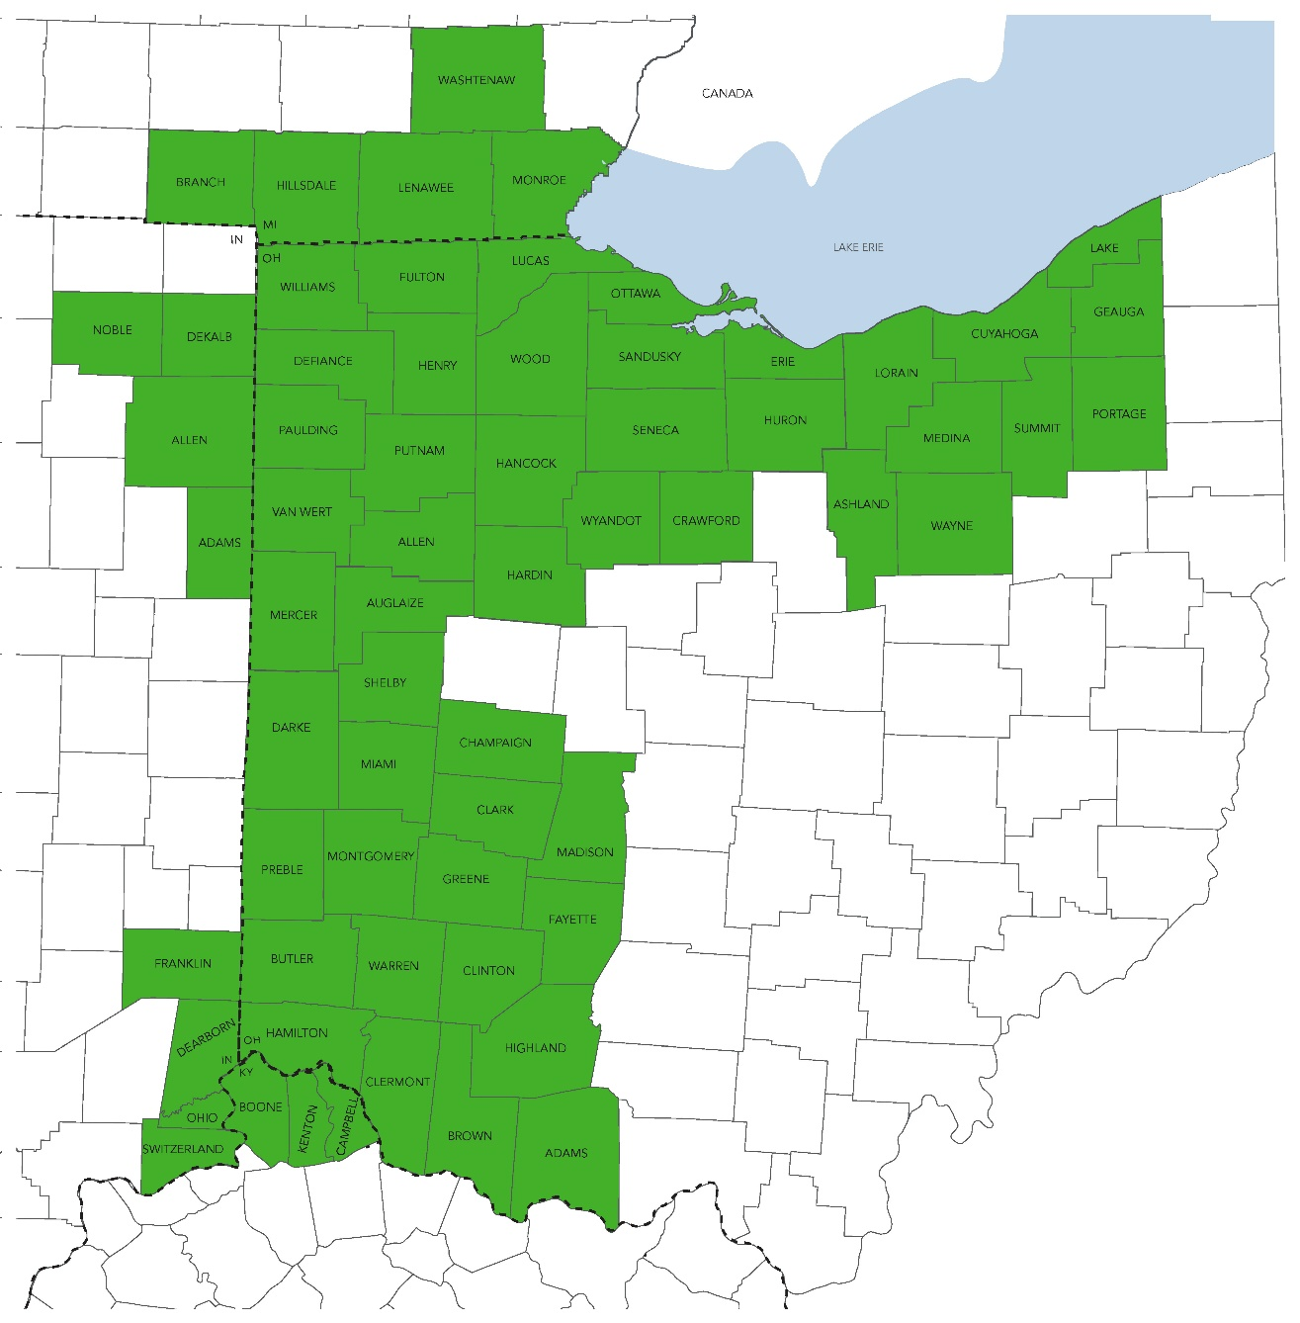
2024 new counties
INDIANA
Franklin
Ohio
Switzerland
OHIO
Adams
Ashland
Crawford
Fayette
Geauga
Highland
Madison
Mercer
Portage
KENTUCKY
Boone
Campbell
Kenton
Seneca
Van Wert
Wayne
Wyandot
Notes:
Designer: Can we have the new counties in a different color?

Slide 10

Plan designs by market
STATE |  | COUNTIES | New! HMO-POS | New! PPO | New! MED-ONLY PPO
Ohio | Northwest Ohio | Adams, Crawford, Erie, Fulton, Hardin, Huron, Lucas, Mercer, Ottawa, Paulding, Putnam, Sandusky, Seneca, Van Wert, Wayne, Williams, Wood, Wyandot.
 | Northeast Ohio | Ashland, Cuyahoga, Geauga, Lake , Lorain, Medina, Portage, Summit, Wayne.
 | Southwest Ohio | Auglaize, Brown, Butler, Champaign, Clark, Clermont, Clinton, Darke, Fayette, Greene, Hamilton, Highland, Madison, Miami, Montgomery, Preble, Shelby, Warren.

Slide 11
Plan designs by market
STATE |  | COUNTIES | New! HMO-POS | New! PPO | New! MED-ONLY PPO
Michigan | Southeast Michigan | Branch, Hillsdale, Lenawee, Monroe, Washtenaw.
Kentucky | Northern Kentucky | Boone, Campbell, Kenton.
Indiana | Eastern Indiana | Adams, Allen, Dearborn, DeKalb, Franklin, Ohio, Noble, Switzerland.

Slide 12
Paramount plan enhancements
1.
New $0 PPO plan with a $0 deductible available across our 47 Ohio county service area.
2.
Tier 1 and Tier 2 drugs moved to a $0 copay on every plan for 30 and 90-day standard retail and mail order.
3.
$2,500-5,000 maximum dental plan allowance and increased ADA codes, including crowns.
4.
New $0 PPO MA-Only plan with $50 Part B rebate available throughout 47 Ohio county service area.
5.
$200 combined vision-wear allowance with EyeMed. Vision provider network providers include Wal-Mart, Lenscrafters and others.

Slide 13
Northwest Ohio AND southeast Michigan
2

Slide 14
Northwest Ohio & Southeast Michigan
2024 hmo-POS plans
Plan | Elite Standard (HMO-POS) | Elite Prime (HMO-POS) | Elite Enhanced (HMO-POS)
Premium | $0 | $28 | $68
Deductible | $0 | $0 | $0
Max. Out-of-Pocket | $4,200 | $3,700 | $3,600
PCP | $0 copay | $0 copay | $0 copay
Specialist | $35 copay | $35 copay | $35 copay
Inpatient Hospital | $325 copay per day for days 1-5 (per each hospital stay) | $310 copay per day for days 1-5 (per each hospital stay) | $225 copay per day for days 1-5 (per each hospital stay)
Skilled Nursing Facility | Days 1-20 $0 copay per day. Days 21-100 $188 copay per day (100-day limit). | Days 1-20 $0 copay per day. Days 21-100 $196 copay per day (100-day limit). | Days 1-20 $0 copay per day. Days 21-100 $188 copay per day (100-day limit).
Outpatient Lab Services | $0 – $5 copay per visit | $0 – $5 copay per visit | $0 – $5 copay per visit
Outpatient Diagnostic Tests, such as ultrasound and cardiac echocardiogram | $20 copay per visit | $15 copay per visit | $10 copay per visit
Preventive and Comprehensive Dental Benefit | $2,500 | $2,500 | $5,000

Slide 15
Northwest Ohio & Southeast Michigan prescriptions
 | Elite Standard (HMO-POS) | Elite Prime (HMO-POS) | Elite Enhanced (HMO-POS)
Deductible | $0 | $0 | $0
Tier 1 Preferred Generic (Gap Coverage) | • $0 copay for 30-day supply standard retail. • $0 copay for 90-day supply standard retail. • $0 copay for 90-day supply mail order. | • $0 copay for 30-day supply standard retail. • $0 copay for 90-day supply standard retail. • $0 copay for 90-day supply mail order. | • $0 copay for 30-day supply standard retail. • $0 copay for 90-day supply standard retail. • $0 copay for 90-day supply mail order.
Tier 2 Generic (Gap Coverage) | • $0 copay for 30-day supply standard retail. • $0 copay for 90-day supply standard retail. • $0 copay for 90-day supply mail order. | • $0 copay for 30-day supply standard retail. • $0 copay for 90-day supply standard retail. • $0 copay for 90-day supply mail order. | • $0 copay for 30-day supply standard retail. • $0 copay for 90-day supply standard retail. • $0 copay for 90-day supply mail order.
Tier 3 Preferred Brand | • $45 copay for 30-day supply standard retail. • $135 copay for 90-day supply standard retail. • $90 copay for 90-day supply mail order. | • $45 copay for 30-day supply standard retail. • $135 copay for 90-day supply standard retail. • $90 copay for 90-day supply mail order. | • $42 copay for 30-day supply standard retail. • $126 copay for 90-day supply standard retail. • $84 copay for 90-day supply mail order.
Tier 4 Non-Preferred | • $100 copay for 30-day supply standard retail. • $300 copay for 90-day supply standard retail. • $200 copay for 90-day supply mail order. | • $100 copay for 30-day supply standard retail. • $300 copay for 90-day supply standard retail. • $200 copay for 90-day supply mail order. | • $100 copay for 30-day supply standard retail. • $300 copay for 90-day supply standard retail. • $200 copay for 90-day supply mail order.
Tier 5 Specialty | 33% coinsurance | 33% coinsurance | 33% coinsurance
All Paramount Elite (HMO/PPO) plans utilize a standard pharmacy network with preferred contracted rates.

Slide 16
Northwest Ohio & Southeast Michigan
2024 ppo plans
Plan | Elite Preferred (PPO) In-Network/Out-of-Network | Elite Courage Med-Only (PPO) In-Network/Out-of-Network
Premium | $0 | $0
Part B Premium Rebate |  | $50
Max. Out-of-Pocket | $5,300/$7,500 | $5,900/$8,950
PCP | $0/$25 copay per visit | $0 copay per visit/30% coinsurance
Specialist | $30 copay per visit/40% coinsurance | $35 copay per visit/30% coinsurance
Inpatient Hospital | $360 copay per day for days 1-5. $0 copay for days 6-90 (per each hospital stay). Out-of-network: 10% coinsurance. | $300 copay per day for days 1-5. $0 copay for days 6-90 (per each hospital stay). Out-of-network: 30% coinsurance.
Skilled Nursing Facility | Days 1-20 $0 copay per day. Days 21-100 $188 copay per day (100-day limit). Out-of-network: 30% coinsurance. | Days 1-20 $0 copay per day. Days 21-100 $196 copay per day (100-day limit). Out-of-network: 30% coinsurance.
Outpatient Lab Services | $10 copay per visit/10% coinsurance | $5 copay per visit/30% coinsurance
Diagnostic Tests | $50 copay per visit/10% coinsurance | $10 copay per visit/30% coinsurance
Preventive and Comprehensive Dental Benefit | $5,000 | $2,500

Slide 17
Northwest Ohio & Southeast Michigan prescriptions
 | Elite Preferred (PPO) | Elite Courage (PPO)
Deductible | $0 | Does not include Part D benefits
Tier 1 Preferred Generic (Gap Coverage) | • $0 copay for 30-day supply standard retail. • $0 copay for 90-day supply standard retail. • $0 copay for 90-day supply mail order.
Tier 2 Generic | • $0 copay for 30-day supply standard retail. • $0 copay for 90-day supply standard retail. • $0 copay for 90-day supply mail order.
Tier 3 Preferred Brand | • $45 copay for 30-day supply standard retail. • $135 copay for 90-day supply standard retail. • $90 copay for 90-day supply mail order.
Tier 4 Non-Preferred | • $100 copay for 30-day supply standard retail. • $300 copay for 90-day supply standard retail. • $200 copay for 90-day supply mail order.
Tier 5 Specialty | 33% coinsurance
All Paramount Elite (HMO/PPO) plans utilize a standard pharmacy network with preferred contracted rates.

Slide 18

Northwest Ohio & Southeast Michigan
Dental benefits
2024 | PARAMOUNT DENTAL PLAN BENEFITS
Annual Maximum Plan Payment | $2,500 – $5,000 for preventive and comprehensive dental services combined.
Deductible | $0
Embedded PPO Preventive Dental and Comprehensive Dental Benefits In-Network: $0 copay Out-of-Network: 30% coinsurance Dental Networks: Paramount Dental. DenteMax. Connection Dental. | Preventive Benefits with $0 copay for: 2 periodic exams. 2 teeth cleanings. 2 fluoride treatments. 4 (one-set) dental bitewing X-rays per calendar year. Comprehensive Benefits with $0 copay for: Fillings. Root canals. Crowns. Periodontal maintenance. Extractions. See Evidence of Coverage for additional details about endodontics, periodontics, prosthodontics and restorative coverage.

Slide 19

Northwest Ohio & Southeast Michigan
Provider network
ProMedica.
Mercy Health.
The Toledo Clinic.
The University of Toledo Medical Center.
Wood County Hospital.
Visit myparamount.org/provider-search for a complete listing of providers and facilities.

Slide 20
Northeast Ohio
3

Slide 21
Northeast Ohio
2024 hmo-pos plans
Plan | Elite NE Ohio Standard (HMO-POS) | Elite NE Ohio Prime (HMO-POS)
Premium | $0 | $62
Deductible | $0 | $0
Max. Out-of-Pocket | $3,600 | $4,000
PCP | $0 copay per visit | $0 copay per visit
Specialist | $35 copay per visit | $35 copay per visit
Inpatient Hospital | $300 copay per day for days 1-5 (per each hospital stay) | $295 copay per day for days 1-5 (per each hospital stay)
Skilled Nursing Facility | Days 1-20 $0 copay per day. Days 21-100 $188 copay per day (100-day limit). | Days 1-20 $0 copay per day. Days 21-100 $188 copay per day (100-day limit).
Outpatient Lab Services | $0 – $10 copay per visit | $0 – $5 copay per visit
Outpatient Diagnostic Tests | $30 copay per visit | $20 copay per visit
Preventive and Comprehensive Dental Benefit | $2,500 | $2,500

Slide 22
Northeast Ohio prescriptions
 | Elite NE Ohio Standard (HMO-POS) | Elite NE Ohio Prime (HMO-POS)
Deductible | $0 | $0
Tier 1 Preferred Generic (Gap Coverage) | • $0 copay for 30-day supply standard retail. • $0 copay for 90-day supply standard retail. • $0 copay for 90-day supply mail order. | • $0 copay for 30-day supply standard retail. • $0 copay for 90-day supply standard retail. • $0 copay for 90-day supply mail order.
Tier 2 Generic | • $0 copay for 30-day supply standard retail. • $0 copay for 90-day supply standard retail. • $0 copay for 90-day supply mail order. | • $0 copay for 30-day supply standard retail. • $0 copay for 90-day supply standard retail. • $0 copay for 90-day supply mail order.
Tier 3 Preferred Brand | • $45 copay for 30-day supply standard retail. • 135 copay for 90-day supply standard retail. • $90 copay for 90-day supply mail order. | • $45 copay for 30-day supply standard retail. • 135 copay for 90-day supply standard retail. • $90 copay for 90-day supply mail order.
Tier 4 Non-Preferred | • $100 copay for 30-day supply standard retail. • $300 copay for 90-day supply standard retail. • $200 copay for 90-day supply mail order. | • $100 copay for 30-day supply standard retail. • $300 copay for 90-day supply standard retail. • $200 copay for 90-day supply mail order.
Tier 5 Specialty | 30% coinsurance | 30% coinsurance
All Paramount Elite (HMO/PPO) plans utilize a standard pharmacy network with preferred contracted rates.

Slide 23
Northeast Ohio
2024 ppo plans
Plan | Elite Preferred (PPO) In-Network/Out-of-Network | Elite Courage Med-Only (PPO) In-Network/Out-of-Network
Premium | $0 | $0
Part B Premium Rebate |  | $50
Max. Out-of-Pocket | $5,300/$7,500 | $5,900/$8,950
PCP | $0/$25 copay per visit | $0 copay per visit/30% coinsurance
Specialist | $30 copay per visit/40% coinsurance | $35 copay per visit/30% coinsurance
Inpatient Hospital | $360 copay per day for days 1-5. $0 copay for days 6-90 (per each hospital stay). Out-of-network: 10% coinsurance. | $300 copay per day for days 1-5. $0 copay for days 6-90 (per each hospital stay). Out-of-network: 30% coinsurance.
Skilled Nursing Facility | Days 1-20 $0 copay per day. Days 21-100 $188 copay per day (100-day limit). Out-of-network: 30% coinsurance. | Days 1-20 $0 copay per day. Days 21-100 $196 copay per day (100-day limit). Out-of-network: 30% coinsurance.
Outpatient Lab Services | $10 copay per visit/10% coinsurance | $5 copay per visit/30% coinsurance
Diagnostic Tests | $50 copay per visit/10% coinsurance | $10 copay per visit/30% coinsurance
Preventive and Comprehensive Dental Benefit | $5,000 | $2,500

Slide 24
Northeast Ohio prescriptions
 | Elite Preferred (PPO) | Elite Courage (PPO)
Deductible | $0 | Does not include Part D Benefits
Tier 1 Preferred Generic (Gap Coverage) | • $0 copay for 30-day supply standard retail. • $0 copay for 90-day supply standard retail. • $0 copay for 90-day supply mail order.
Tier 2 Generic | • $0 copay for 30-day supply standard retail. • $0 copay for 90-day supply standard retail. • $0 copay for 90-day supply mail order.
Tier 3 Preferred Brand | • $45 copay for 30-day supply standard retail. • $135 copay for 90-day supply standard retail. • $90 copay for 90-day supply mail order.
Tier 4 Non-Preferred | • $100 copay for 30-day supply standard retail. • $300 copay for 90-day supply standard retail. • $200 copay for 90-day supply mail order.
Tier 5 Specialty | 33% coinsurance
All Paramount Elite (HMO/PPO) plans utilize a standard pharmacy network with preferred contracted rates.

Slide 25
Northeast Ohio
Dental benefits
2024 | PARAMOUNT DENTAL PLAN BENEFITS
Annual Maximum Plan Payment | $2,500 – $5,000 for preventive and comprehensive dental services combined.
Deductible | $0
Embedded PPO Preventive Dental and Comprehensive Dental Benefits In-Network: $0 copay Out-of-Network: 30% coinsurance Dental Networks: Paramount Dental. DenteMax. Connection Dental. | Preventive Benefits with $0 copay for: 2 periodic exams. 2 teeth cleanings. 2 fluoride treatments. 4 (one-set) dental bitewing X-rays per calendar year. Comprehensive Benefits with $0 copay for: Fillings. Root canals. Crowns. Periodontal maintenance. Extractions. See Evidence of Coverage for additional details about endodontics, periodontics, prosthodontics and restorative coverage.

Slide 26
Northeast Ohio
Provider network
Cleveland Clinic.
MetroHealth.
University Hospitals.
And many more!
Visit myparamount.org/provider-search for a complete listing.

Slide 27
Southwest Ohio and Northern Kentucky
4

Slide 28
Southwest Ohio & Northern Kentucky
2024 hmo-pos plan
Plan | Elite Essential (HMO-POS)
Premium | $0
Deductible | $0
Max. Out-of-Pocket | $4,400
PCP | $0 copay per visit
Specialist | $35 copay per visit
Inpatient Hospital | $350 copay per day for days 1-5 (per each hospital stay)
Skilled Nursing Facility | Days 1-20 $0 copay per day. Days 21-100 $188 copay per day (100-day limit).
Outpatient Lab Services | $0 – $10 copay per visit
Outpatient Diagnostic Tests | $20 copay per visit
Preventive and Comprehensive Dental Benefit | $2,500

Slide 29
Southwest Ohio & Northern Kentucky prescriptions
 | Elite Essential (HMO-POS)
Deductible | $0
Tier 1 Preferred generic (Gap Coverage) | • $0 copay for 30-day supply standard retail. • $0 copay for 90-day supply standard retail. • $0 copay for 90-day supply mail order.
Tier 2 Generic (Gap Coverage) | • $0 copay for 30-day supply standard retail. • $0 copay for 90-day supply standard retail. • $0 copay for 90-day supply mail order.
Tier 3 Preferred Brand | • $45 copay for 30-day supply standard retail. • 135 copay for 90-day supply standard retail. • $90 copay for 90-day supply mail order.
Tier 4 Non-Preferred | • $100 copay for 30-day supply standard retail. • $300 copay for 90-day supply standard retail. • $200 copay for 90-day supply mail order.
Tier 5 Specialty | 33% coinsurance
All Paramount Elite (HMO/PPO) plans utilize a standard pharmacy network with preferred contracted rates.

Slide 30
Only Available in Ohio
2024 ppo plans
Plan | Elite Preferred (PPO) In-Network/Out-of-Network | Elite Courage Med-Only (PPO) In-Network/Out-of-Network
Premium | $0 | $0
Part B Premium Rebate |  | $50
Max. Out-of-Pocket | $5,300/$7,500 | $5,900/$8,950
PCP | $0/$25 copay per visit | $0 copay per visit/30% coinsurance
Specialist | $30 copay per visit/40% coinsurance | $35 copay per visit/30% coinsurance
Inpatient Hospital | $360 copay per day for days 1-5. $0 copay for days 6-90 (per each hospital stay). Out-of-network: 10% coinsurance. | $300 copay per day for days 1-5. $0 copay for days 6-90 (per each hospital stay). Out-of-network: 30% coinsurance.
Skilled Nursing Facility | Days 1-20 $0 copay per day. Days 21-100 $188 copay per day (100-day limit). Out-of-network: 30% coinsurance. | Days 1-20 $0 copay per day. Days 21-100 $196 copay per day (100-day limit). Out-of-network: 30% coinsurance.
Outpatient Lab Services | $10 copay per visit/10% coinsurance | $5 copay per visit/30% coinsurance
Diagnostic Tests | $50 copay per visit/10% coinsurance | $10 copay per visit/30% coinsurance
Preventive and Comprehensive Dental Benefit | $5,000 | $2,500

Slide 31
Only Available in Ohio prescriptions
 | Elite Preferred (PPO) | Elite Courage (PPO)
Deductible | $0 | Does not include Part D Benefits
Tier 1 Preferred Generic (Gap Coverage) | • $0 copay for 30-day supply standard retail. • $0 copay for 90-day supply standard retail. • $0 copay for 90-day supply mail order.
Tier 2 Generic | • $0 copay for 30-day supply standard retail. • $0 copay for 90-day supply standard retail. • $0 copay for 90-day supply mail order.
Tier 3 Preferred Brand | • $45 copay for 30-day supply standard retail. • $135 copay for 90-day supply standard retail. • $90 copay for 90-day supply mail order.
Tier 4 Non-Preferred | • $100 copay for 30-day supply standard retail. • $300 copay for 90-day supply standard retail. • $200 copay for 90-day supply mail order.
Tier 5 Specialty | 33% coinsurance
All Paramount Elite (HMO/PPO) plans utilize a standard pharmacy network with preferred contracted rates.

Slide 32
Southwest Ohio & Northern Kentucky
Dental benefits
2024 | PARAMOUNT DENTAL PLAN BENEFITS
Annual Maximum Plan Payment | $2,500 – $5,000 for preventive and comprehensive dental services combined.
Deductible | $0
Embedded PPO Preventive Dental and Comprehensive Dental Benefits In-Network: $0 copay Out-of-Network: 30% coinsurance Dental Networks: Paramount Dental. DenteMax. Connection Dental. | Preventive Benefits with $0 copay for: 2 periodic exams. 2 teeth cleanings. 2 fluoride treatments. 4 (one-set) dental bitewing X-rays per calendar year. Comprehensive Benefits with $0 copay for: Fillings. Root canals. Crowns. Periodontal maintenance. Extractions. See Evidence of Coverage for additional details about endodontics, periodontics, prosthodontics and restorative coverage.

Slide 33
Southwest Ohio & Northern Kentucky
Provider network
Mercy Health.
Premier Health.
St. Elizabeth Healthcare.
The Christ Hospital.
UC Health.
And many more!
Visit myparamount.org/provider-search for a complete listing.

Slide 34
INDIANA
5

Slide 35
Indiana
2023 hmo-POS plan
Plan | Elite Indiana Essential (HMO-POS)
Premium | $0
Deductible | $0
Max. Out-of-Pocket | $3,500
PCP | $0 copay per visit
Specialist | $30 copay per visit
Inpatient Hospital | $250 copay per day for days 1-5 (per each hospital stay)
Skilled Nursing Facility | Days 1 – 20 $0 copay per day. Days 21 – 100 $188 copay per day (100-day limit).
Outpatient Lab Services | $0 copay per visit
Outpatient Diagnostic Tests | $100 copay per visit
Preventive and Comprehensive Dental Benefit | $2,500

Slide 36
Indiana prescriptions
 | Elite Indiana Essential (HMO-POS)
Deductible | $0
Tier 1 Preferred generic (Gap Coverage) | • $0 copay for 30-day supply standard retail. • $0 copay for 90-day supply standard retail. • $0 copay for 90-day supply mail order.
Tier 2 Generic (Gap Coverage) | • $0 copay for 30-day supply standard retail. • $0 copay for 90-day supply standard retail. • $0 copay for 90-day supply mail order.
Tier 3 Preferred Brand | • $45 copay for 30-day supply standard retail. • $135 copay for 90-day supply standard retail. • $90 copay for 90-day supply mail order.
Tier 4 Non-Preferred | • $100 copay for 30-day supply standard retail. • $300 copay for 90-day supply standard retail. • $200 copay for 90-day supply mail order.
Tier 5 Specialty | 33% coinsurance
All Paramount Elite (HMO/PPO) plans utilize a standard pharmacy network with preferred contracted rates.

Slide 37
Indiana
Dental benefits
2024 | PARAMOUNT DENTAL PLAN BENEFITS
Annual Maximum Plan Payment | $2,500 for preventive and comprehensive dental services combined.
Deductible | $0
Embedded PPO Preventive Dental and Comprehensive Dental Benefits In-Network: $0 copay Out-of-Network: 30% coinsurance Dental Networks: Paramount Dental. DenteMax. Connection Dental. | Preventive Benefits with $0 copay for: 2 periodic exams. 2 teeth cleanings. 2 fluoride treatments. 4 (one-set) dental bitewing X-rays per calendar year. Comprehensive Benefits with $0 copay for: Fillings. Root canals. Crowns. Periodontal maintenance. Extractions. See Evidence of Coverage for additional details about endodontics, periodontics, prosthodontics and restorative coverage.

Slide 38
Indiana
Provider network
Mercy Health.
Parkview Health.
Parkview Orthopedic Hospital North.
St. Elizabeth Dearborn Hospital.
Visit myparamount.org/provider-search for a complete listing.

Slide 39
Supplemental benefits
6

Slide 40



Over-the-Counter Benefit
Members receive up to $130 allowance every calendar quarter* for over-the-counter (OTC) items through a mail-order catalog and/or retail.
SilverSneakers®
No-cost fitness membership.
Hearing Benefit
$0 copay for routine hearing exam (one visit per year). Hearing aid benefit up to $675 per year/per ear. All types (inner, outer, over) at $0 copay.
Meal Benefit
After an inpatient or skilled nursing facility stay, plan provides two meals a day for 14 days (maximum of four weeks per year).
Non-Emergent Transportation
Members receive 24 one-way trips (taxi, rideshare or van) for $0 copay.**
Wellness Incentive
Earn up to $80 on a refillable benefits card.
Personal Emergency Response (PERS)
Available on all plans with $0 cost share.**
Virtual Doctor Visit
PCP and behavioral health virtual visits at same low copays as in-person visits.
*Varies based on plan choice.
**Not available in PPO.

Slide 41

THANK YOU
paramount.elite@promedica.org
888-891-0707

