Slide 1
Grow Your Agent & Agency Business in 2025​
Learn How The Proprietary LARC System Is Built For This​
Notes:
Good Afternoon, My name is Scott Truka and I am joined by Sean Ruggiero. Sean and I are in charge of sales are Brokers International an Integrity owned company.
Today we are going to show you, whether you’re an agent or an agency, how to grow your business in 2025. This will be accomplished with our LARC (Life and Annuity Resource Center) system. Sean can you tell us about the potential by using this system?

Slide 2
The Potential
Most health agents can significantly increase their business, through life and annuity sales
No New Licensing (assuming life license obtained)
No Leads To Purchase
No New Clients To Meet
Simply utilizing the LARC system & training from Brokers International you can achieve this!
Notes:
That's right Scott. Health agents who are out there helping their clients with their Medsup, Medadvantage, ACA and other health care needs, are in the perfect position to grow their business and increase their business. Best of all, assuming you also have your life insurance license, it doesn't require any sort of additional licensing or securities training. There are no leads to purchase. The same clients that you sat with yesterday, the ones you will meet today and those that you sill see tomorrow, are exactly who you can help. By utilizing the exclusive and proprietary LARC system from Brokers International, you'll have everything you need to accomplish this. However, there are some challenges. Scott?

Slide 3
The Problem
Health agents are…
Too busy
Not confident
Not compliant
Not trained
Not supported
Annuities & Life Insurance is…
Too complicated
Too numerous
Always changing
Difficult to apply to a client's situation with confidence
Notes:
That's correct Sean. As health agents, many of your are way too busy, especially during open enrollment. Many of you may not feel confident in having these discussions with your client and of course we all want to be compliant when making any type of recommendations. Additional concerns are not properly trained and supported. But when you look at annuities and life specifically, you probably think the products are complicated, there are too many options and they are always changing, whether its rates or features. And last but not least, how do I sell this to a client with confidence.

Slide 4
Life Opportunity
Notes:
**NOTES TO PRESENTER- Hide this slide if presenting to annuity only group**
Explain how the agency and BI can work together to support life insurance sales
Why do I think this market opportunity is so large?​
Let’s look at some of the facts.​
First – over 30 million small business owners in the U.S. – that is a lot of prospects. If you think about it that is a million for each of you. That should be enough to last you for an entire career, right? But in addition, they have millions of highly paid employees who are also prospects. We will be talking about opportunities with both owners and their top employees.​
Second – these prospects have money. And as we will talk about later, it is a lot easier to get them to write a check from their business checkbook than their personal checkbook​
Third – Today, only 1 in 4 business owners have a financial strategy for retirement in the form of a written plan. And who specializes in helping clients with retirement income plans? All of us in this room.​
Finally – there is a low confidence level in their ability to retire. This isn’t just a phenomenon for the working class. This applies to business owners as well.​

Slide 5
LIMRA study shows Interest in Life Insurance is at an All-time High¹
39% of Americans in next year
44% of Gen Z (adults)
50% of Millennials
Social Security pays the surviving spouse or child a $255 death benefit if they meet certain requirements²
¹www.limra.com/en/newsroom/news-releases/2023/new-study-shows-interest-in-life-insurance-at-all-time-high-in-2023
²https://www.ssa.gov/faqs/en/questions/KA-02083.html#:~:text=In%20addition%2C%20a%20one%2Dtime,of%20the%20number%20holder's%20death.
Notes:
**NOTES TO PRESENTER- Hide this slide if presenting to annuity only group**
While two-thirds of Americans report their lives have largely returned to normal following the COVID-19 pandemic, the 2023 Insurance Barometer Study shows a record-high proportion of consumers (39%) who say they intend to purchase life insurance coverage within the next year. The intent to buy is even higher among Gen Z adults (44%) and millennials (50%)
Gen Z born during the late 1990s and early 2000s (1997- 2012)
Millennials (Gen Y) born 1981-1996-in 2024 ages 29-43
Source: https://www.limra.com/en/newsroom/news-releases/2023/new-study-shows-interest-in-life-insurance-at-all-time-high-in-2023
A surviving spouse or child may receive a special lump-sum death payment of $255 if they meet certain requirements.
Source: https://www.ssa.gov/faqs/en/questions/KA-02083.html#:~:text=In%20addition%2C%20a%20one%2Dtime,of%20the%20number%20holder's%20death

Slide 6
Myths about Life Insurance
Only useful at death - no living benefits
Too expensive
“Term” Insurance is only option
Not eligible because too old or pre-existing condition
Don’t understand tax benefits
https://www.forbes.com/advisor/in/life-insurance/10-life-insurance-myths-that-need-to-be-debunked/
Notes:
**NOTES TO PRESENTER- Hide this slide if presenting to annuity only group**
There are many common myths about life insurance. Here are a few. [refer to list] Explain each of these myths and the reality of each.
1. Today's life insurance products can offer more than just death benefits. Many permanent life insurance options include living benefits, such as accelerated death benefits, and loan provisions to supplement retirement income. 2. Life insurance premiums can be flexible to accommodate different budgets and a variety of client needs and goals. 3. Term insurance remains an option for some clients, although the industry has evolved to offer several permanent life insurance potential solutions for personal and business uses. 4. Many carriers offer more underwriting options and life insurance solutions that may fit a particular underwriting risk profile. 5. The potential income tax benefit of certain life insurance features can help clients solve specific needs and goals that they may not know about.
Source: https://www.forbes.com/advisor/in/life-insurance/10-life-insurance-myths-that-need-to-be-debunked/

Slide 7
Opportunities
Protection
Legacy
Small Business Solutions
Tax Efficiencies
Notes:
Protection – Life insurance can be used to protect loved ones financially in the event of death. Can be used to replace income, pay off debts, finance future expenditures.
Legacy – Life insurance can provide funds to children, grandchildren, nonprofits/philanthropy, finance education for loved ones.
Small Business Solutions – Life insurance can be used to finance the transfer of a business or to keep/incent key employees
Tax Efficiencies – Life insurance can potentially provide tax-free income during retirement and the tax-free proceeds can be used to transfer wealth on a tax-advantaged basis.

Slide 8
Why Sell Life Insurance?
Be a holistic agent/financial professional
Your clients need life insurance
Additional revenue for you
Protect your book of business
Resources and support
Notes:
Why sell life insurance?
To be a holistic agent/financial professional – be the one-stop shop for all your clients’ financial and health needs
Your clients need life insurance – people buy life insurance for the many benefits they provide; they might as well buy it from you
Additional revenue for you – by simply adding life insurance to your product suite you can add tens of thousands of dollars to your bottom line per year
Protect your book of business. Why have your clients deal with another agent for life insurance? What if that agent sells health insurance too?
Resources and support – Through your wholesaler you have access to industry-leading resources and a host of support services through Brokers International.

Slide 9
Annuity Opportunity
Notes:
**NOTES TO PRESENTER- Hide this slide if presenting to life only group**
We want to spend some time today talking abut the marketplace for retirement products and why we focus our efforts helping Americans plan for retirement income using fixed annuity products. To fully understand the opportunity let’s start by talking about the retirement marketplace.

Slide 10
Nearly 70% of baby boomers are at risk of not being able to replace their pre-retirement lifestyle¹
Current projections forecast a 65-year-old could live 20 more years on average²
¹https://corporate.vanguard.com/content/corporatesite/us/en/corp/articles/more-boomers-prepared-retirement-but-gaps-persist.html
²https://thehill.com/business/personal-finance/3991136-nearly-half-of-baby-boomers-have-no-retirement-savings/
Notes:
**NOTES TO PRESENTER- Hide this slide if presenting to life only group**
Nearly 70% of baby boomers are at risk of not being able to replace their pre-retirement lifestyle
Born between 1946 and 1964
About 53% of "peak boomers," or the tail end of the generation who will turn 65 between 2024 and 2030, have less than $250,000 in assets³
One-third of these younger boomers will rely on Social Security benefits for at least 90% of their retirement income when they are 70
Current projections forecast a 65-year-old could live 20 more years on average

Slide 11
Stark difference in access to a defined benefit plan (pension) between private industry workers and state/local government employees¹
15% of private industry workers
86% of state and local government workers
Millennial children set to inherit $68 trillion²
¹https://www.bls.gov/charts/employee-benefits/percent-access-participation-takeup-retirement-benefits.htm
²https://www.forbes.com/sites/jackkelly/2023/08/09/the-great-wealth-transfer-from-baby-boomers-to-millennials-will-impact-the-job-market-and-economy/?sh=42c46f83e4aa
Notes:
**NOTES TO PRESENTER- Hide this slide if presenting to life only group**
As of March 2024, only 15 percent of private industry workers had access to a defined benefit plan (pension), compared with 86 percent of state and local government workers.
Boomers are currently the wealthiest generation on the planet. The Baby Boomer generation is expected to leave a significant amount of money to their Millennial children. It's estimated that more than $68 trillion will be bequeathed to their offspring. The great wealth transfer is expected to make Millennials the richest generation in American history.

Slide 12
Why Sell Annuities?
Expanding your business
Reaching business goals
Retaining current clients
Holistic planning
Building your brand
Notes:
Top reasons to sell…
Expand your business, added revenue from another source.
Reach business goals by increasing overall production.
Current database of clients.
Retain clients.
Holistic financial planning.
Brand yourself as a go-to financial professional in your area, get referrals.

Slide 13
The Solution - LARC
SYSTEM
TURN-KEY
MARKETING
TRAINING
LARC
Notes:
All of these questions can be answered with our LARC Solution. This is the Life and Annuity Resource Center. This system is proprietary to Brokers International and includes a training system that will make sure you are confident and compliant when working with your clients. This solution also included a turn-key 52 week marketing program that is whitelabeled to your agency that is proven to increase your life and annuity sales. Now Sean, let's dive into the system.

Slide 14
Life & Annuity Resource Center (LARC)
Notes:
This is an example of the Life & Annuity Resource Center, or LARC. I'll guide you through each of the features.

Slide 15
Life & Annuity Resource Center (LARC)
Notes:
When I got into this industry over 20 years ago, I found immediate success selling life insurance. However, even though I was trying, it took, me over 18 months to sell my first annuity. Why's that? Because I lacked confidence. The same might be true for life insurance, especially whole life and IULs for many of you. That is why the first two sections of the LARC are exclusive ANNUITY and LIFE training that are specifically designed to give you CONFIDENCE.
Each learning module is about 90 minutes long total, and is comprised of multiple, short and relatable videos that are followed by a quick quiz so you can track your progress. When you have finished these, you WILL BE CONFIDENT, and you will have also learned our exclusive ONE QUESTION SALES SYSTEM that will unlock your ability to use the LARC and turn EVERY LAST ONE OF YOUR CLIENTS into POTENTIAL annuity and or life insurance sales.

Slide 16
Life & Annuity Resource Center (LARC)

Slide 17
Life & Annuity Resource Center (LARC)
Notes:
Next, you'll see a link to our proprietary financial inventory, or what we call "Confidential Needs Analysis". This C'NA can be customized to fit your agency's needs, but will always include everything you need to unlock SEVEN POTENTIAL SALES OPPORTUNITIES with every client when this powerful ONE PAGE C.NA is combined with our exclusive sales training. Most importantly, it includes our "GOLDEN QUESTION" that will help guide you to a potential LIFE or ANNUITY sale for every client you sit down with

Slide 18
Life & Annuity Resource Center (LARC)
Notes:
But think about it. For many agents, it is at this point which they get stuck. Asking a question is easy, but knowing which carrier to use, what product to write, knowing if your appointed and what you password it, and then how to run and explain illustrations, all while making sure you document why you are choosing said product for this client. This is truly daunting. That is where the LARC system really shines. All the agent needs to do is click on the Ask A Specialist, and they will simply enter the clients information into the secure, end-to-end encrypted form.

Slide 19
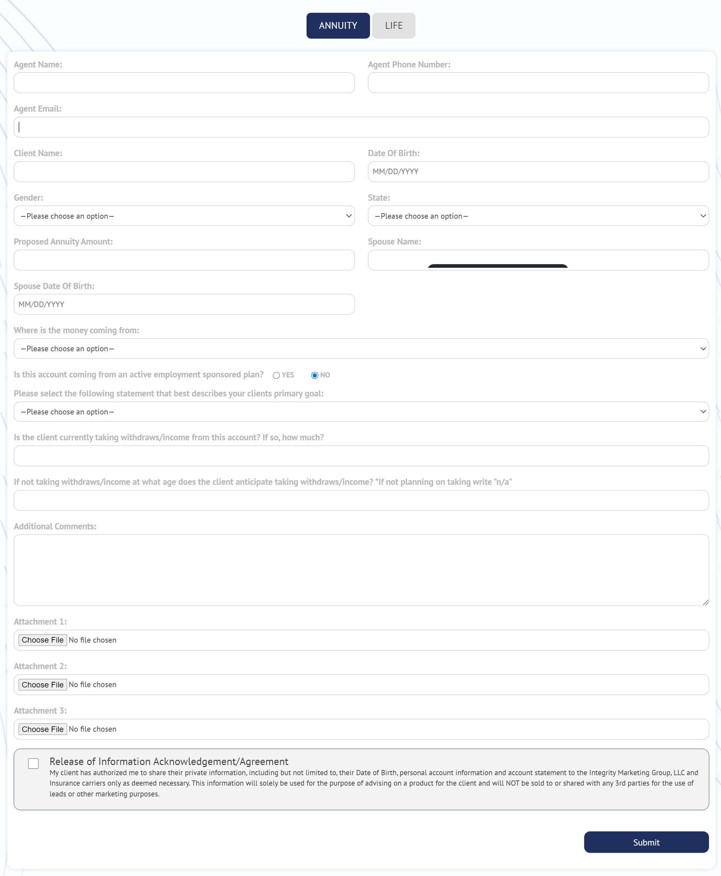
Life & Annuity Resource Center (LARC)
Notes:
This allows the agent to choose ANNUITY or LIFE, based on how the client responded to the GOLDEN QUESTION, and it keeps the agent on a guide wire so they can fill in as much, or as little information as they might have, and what is needed by a team of licensed specialists who will do all the research needed to find products for the client. They will then send this back to the agent, make sure the agent is contracted with the chosen company, include the illustrations, and often times a video or two explaining how to proceed with the sale. All of this is documented, encrypted and stored on the cloud, and if they agent has any more questions, they simply respond!

Slide 20
Life & Annuity Resource Center (LARC)
Notes:
FInally, once the agent is ready to take the application, a link to their eapp is included

Slide 21
Come See Us at Booth #230
Over 50 carriers
Bonus participation
Aggressive day-one comp
Comprehensive support
Notes:
Thanks Sean. Brokers International has been around for over 40 years. We offer over 50 carriers for both life and annuity, there are bonus opportunities, aggressive day 1 compensation and of and all the support we mentioned today. If you would like to learn more about LARC and our sales system or how we are disrupting the industry with our one question sales program, please stop by and see us at booth 230.

Slide 22
THANK YOU!
Notes:
Thank you for attending.

