Slide 1
30-60-90
SALES APPROACH

Slide 2
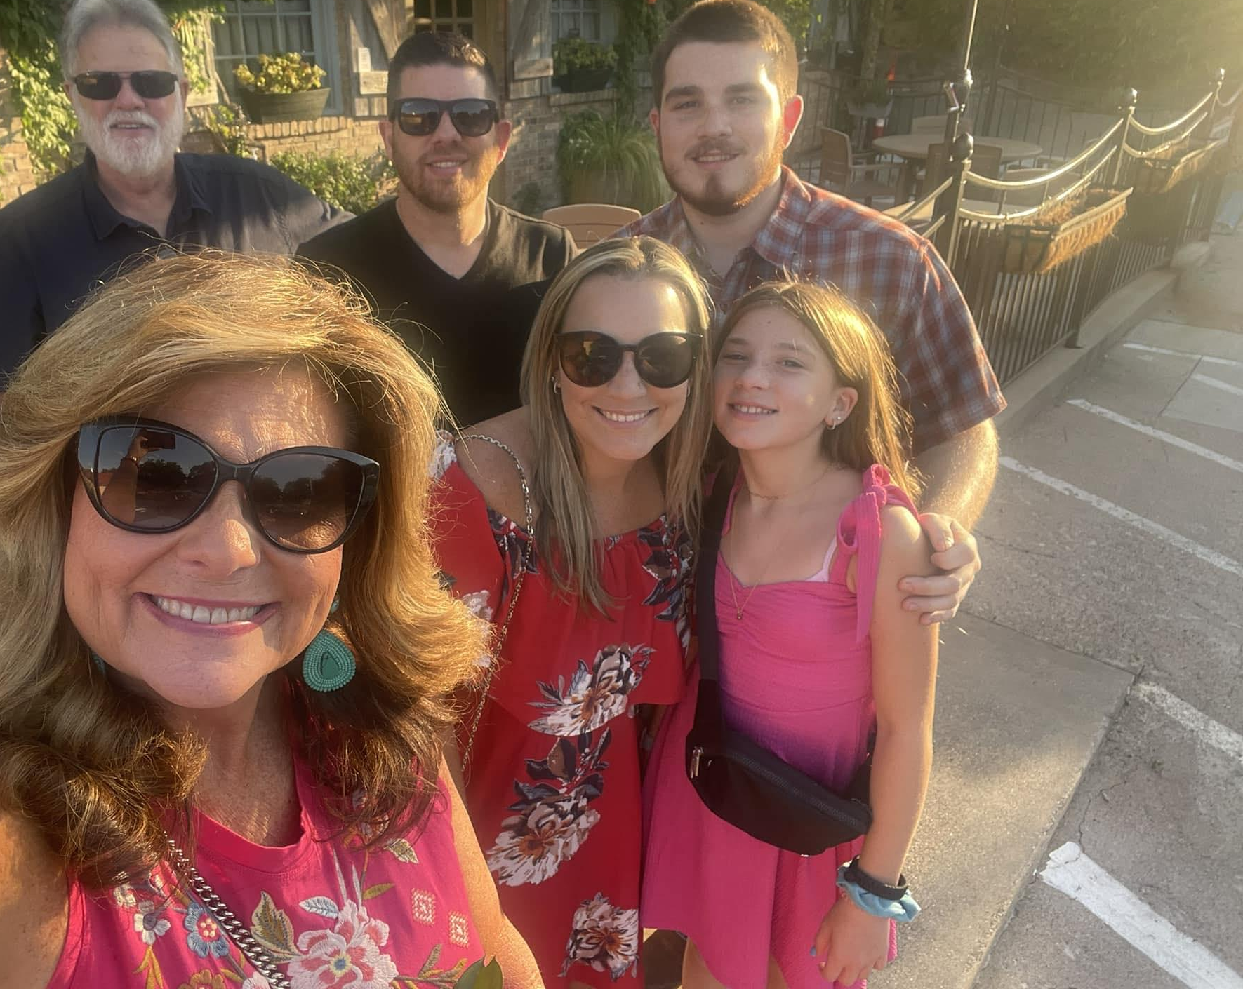
ABOUT GAYLAN - QUEEN OF THE BUNDLE
Founder and Partner of Senior Security Benefits since 2000
CMO 2003- 2011
CEO 2011- Present
Over $120M in sales in 2020 and continued growth
Advisory Council member for Manhattan Life, Aetna & Cigna
Keynote Speaker, Industry Coach & Personal Mentor
Ronald McDonald House Board Member 2016-2022
Ronald McDonald House Board President 2023
Former Board Member of American Heart Association
Founding board member of Fundamental Legacy, Hope Fort Worth & Polished Ministries Mentor
Wife, Mom & Gram
Travel, Music & Reading
#RubyFaith

Slide 3
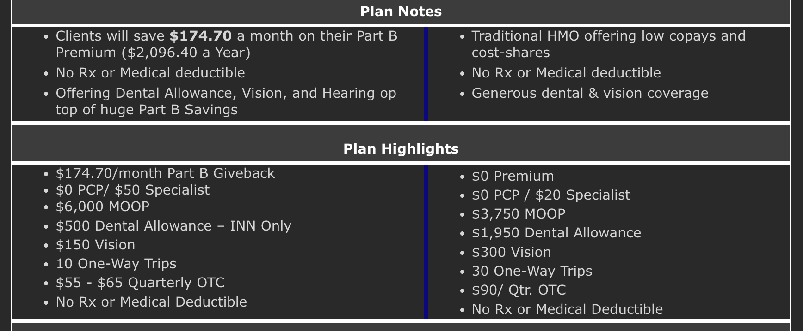
Budget Based Fact Finding
What can you afford, $30, $60 or $90?
“Do you have a ‘Spouse in the House’ that we may be able to use to free up some premium (household discount)?”
Can you really afford that $0 premium plan?
Example from a carrier on how the Give Back opens up the budget!
WE WON’T SHOW YOU WHAT TO DO, WE WILL SHOW YOU HOW TO DO IT!
FOR AGENT USE ONLY

Slide 4
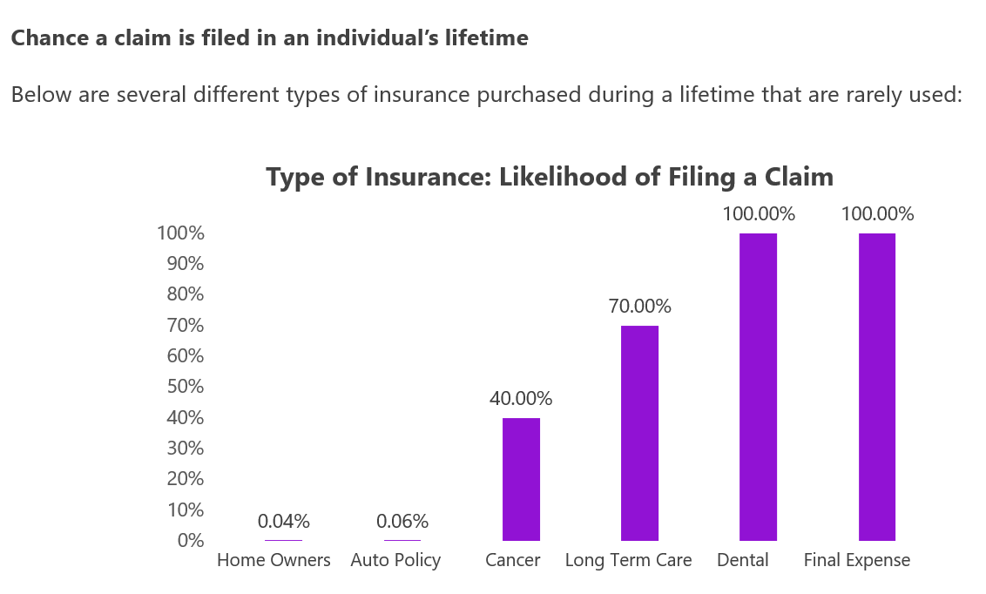
INSURANCE “CLAIMS” UTILIZATION
YOU THE AGENT NEED ALL OF THESE PLANS!
GET CONVICTED!
Required to have two, not required to have the other four. Look how often they would file if they did.
WHAT YOU DO MATTERS!
Information from 2020 Annual Enrollment Period Conference

Slide 5
BE BETTER!
Make sure that your T65 clients understand what their options are. Every T65 client should know ALL OF THE PLANS they need to purchase before they SPEND THE MONEY they DON’T HAVE before it’s too late!
They may want or better yet, NEED to include their adult children!

Slide 6
Why Cancer, Heart Attack, and Stroke Plans?
Cancer is the 2nd most common cause of death
1 out of every 4 deaths
1 out of 2 men, 1 out of 3 women
87% of all cancers are diagnosed ages 50 or older
Heart Attack is the leading cause of death
for both men & women
Stroke Statistics
3rd leading cause of death for women
5th leading cause of death for men
Among the top ten in children
FOR AGENT USE ONLY

Slide 7
COMMON OBJECTIONS
I can’t afford it
I have to talk with someone
Who is going to pay this for you?
FOR AGENT USE ONLY

Slide 8
COMMON OBJECTIONS
“I need to think about it.”
- What are you thinking about? The possibility of you getting cancer? 87% of cancers are diagnosed in people age 50 and above. You want to spend the money on something else? I can promise you that your children or spouse would never object to you investing in something that would take care of a burden instead of creating one.
- Look at it this way, do you need to think about putting gas in your car? No, the only way it goes is with gas. The most expensive drugs are like “gas” when you are diagnosed with cancer. They are life saving

Slide 9
COMMON OBJECTIONS
“I need to check with ________”
I totally understand that. I loved that my mother check with me before making purchases, but I can promise you that any child or spouse will want you to have this coverage. You child may even want to purchase this for you or themselves. Let’s go ahead and get them on the phone, what’s their phone number? I don’t expect you to remember everything I told you, so please let me explain it to them on your behalf.

Slide 10
Aetna Cancer, Heart Attack or Stroke “Plus”
Five Year Look Back in ALL States
“Mix and Match” Benefits
Offer different benefit amounts for cancer and heart attack/stroke!
Recurrence Benefit
100% after 9 years
Persistency protection- Paycheck Protection
Sell Heart Attack or Stroke Only Plans
Lowest Rates Offered by a Major Carrier
Available in AL, AR, AZ, CO, CT, DE, FL, GA, IA, ID, IL, IN, KY, LA, MD, MI, MO, MS, MT, NC, ND, NE, NH, NJ, NV, OH, OK, OR, PA, RI, SC, SD, TN, TX, VA, VT, WA, WI, WV & WY
States Except Texas
Recurrence Period | Amount
2 to less than 5 years | 25%
5 to less than 7 years | 50%
7 to less than 9 years | 75%
9 years or more | 100%
Texas Specific Recurrence
Recurrence Period | Amount
Less than 24 months | 5%
2 to less than 5 years | 20%
5 to less than 7 years | 50%
7 to less than 9 years | 75%
9 years or more | 100%
FOR AGENT USE ONLY

Slide 11
The Ease of Enrollment and Claims Filing
Plans Are Available in 45 States*
Not Available in DC, HI, MA, ME, NH, NY or WA
Enrollment Options:
Electronic application with security questions as client’s e-signature
Paper applications: mail or fax
Payment Options:
Annual, semi-Annual, quarterly or monthly bank draft (EFT)
Check or EFT options
One-Time Claims Filing Process:
Unlike treatment plans that require clients to file a claim after each chemo and radiation treatment
* As of 2/2020
FOR AGENT USE ONLY

Slide 12
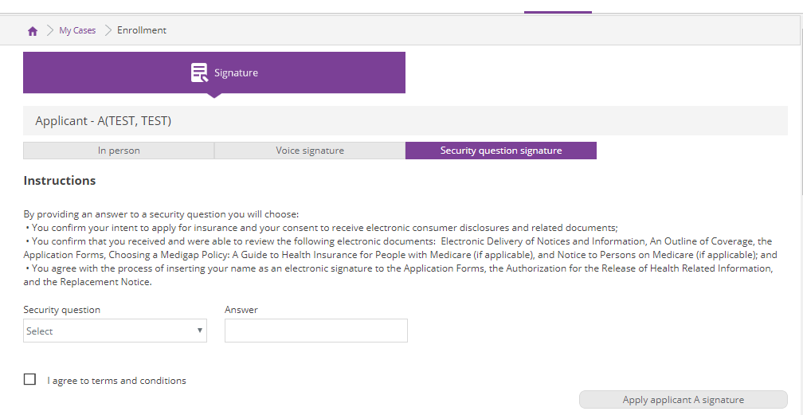
Easy Electronic Application with Security Question as Signature
What is your favorite color?
Name of your first pet?
Father’s middle name?
Mother’s Maiden Name?
High School Mascot?
Name of street you grew up on?
City you were born in?

Slide 13
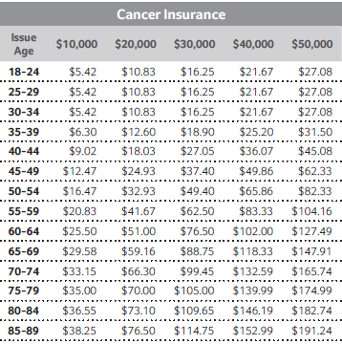
“Plus Plan” Individual Monthly Rates
First Diagnosis Cancer Only
When adult children turn 26 use your CRM and get a new client even younger. Adding to your lifetime values for agent pay.
Cancer doesn’t discriminate…
it doesn’t care when you turn 65!

Slide 14
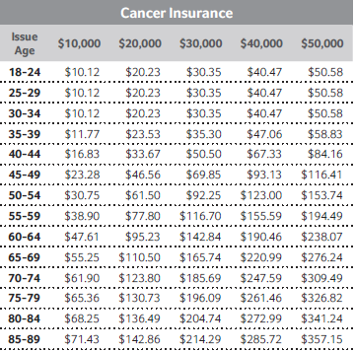
“Plus Plan” Individual & Spouse Monthly Rates
First Diagnosis Cancer Only
Don’t forget
Spouse in the
House
Cancer doesn’t discriminate…
it doesn’t care when you turn 65!

Slide 15
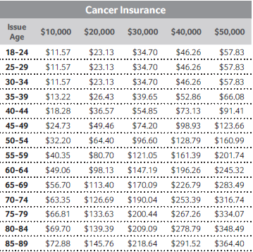
“Plus Plan” Family Monthly Rates
First Diagnosis Cancer Only

Slide 16
Sales Points for Cross Selling CHAS Plans
How many agents have sold their first insurance presentation? Talk about CHAS with EVERY client. Your presentation will get better with practice. Try these points…
Personal Stories
“How many of your family or friends have been impacted by cancer?”
Share your experience with your client
Start the Conversation
Help your client understand their exposure when it comes to cancer, heart attack or stroke
Make them aware of these plans
Spouse in the House
Turning 65 is a great opportunity to present CHAS and other products for their spouse
More Business
Talk to your “leads” with MA plans during the “lock-in” period about the importance of adding a cancer plan to their MA coverage
I’m so happy we did business with Gaylan and not Joe or JJ!
It’s your job to build the best package of protection at the time of presentation with your clients.
FOR AGENT USE ONLY

Slide 17
Medicare Advantage Client
So how do you cover drug costs and
“out of pocket” costs with 30-60-90?
$30 Budget – Lump Sum Cancer
$60 Budget – Lump Sum Cancer or Heart Attack/Stroke + Hospital Indemnity
$90 Budget – Lump Sum Cancer or Heart Attack/Stroke + Hospital Indemnity +
Short Term Recovery Care
FOR AGENT USE ONLY

Slide 18
Medicare Supplement Client
The Medicare Supplement client’s first exposure is dental, vision & hearing costs. Many T65s are already asking you about dental because they are coming off group plans!
Dental is the most requested insurance product, according to Limra
Only 12% of Americans over 65 have dental coverage*
One-third of U.S. adults haven’t been to the dentist in the last year
Medicare has very limited coverage on dental, vision or hearing
Ask your client
“When was the last time you had your teeth cleaned?”
* http://content.healthaffairs.org/content/35/12/2241.abstract
FOR AGENT USE ONLY

Slide 19
Why Cancer, Heart Attack, and Stroke Plans?
Medicare Supplement Client
Medicare Supplement Client
So how do you cover dental and
“out of pocket” costs with 30-60-90?
$30 Budget – Dental, Vision & Hearing
$60 Budget – Dental, Vision & Hearing + Lump Sum Cancer
$90 Budget – Dental, Vision & Hearing + Lump Sum Cancer + Short Term
Recovery Care
FOR AGENT USE ONLY

Slide 20
Spouse in the House/ Under AGE 65 Client
So how do you cover dental and
“out of pocket” costs with 30-60-90?
$30 Budget – Dental, Vision & Hearing
$60 Budget – Dental, Vision & Hearing + Lump Sum Cancer
$90 Budget – Dental, Vision & Hearing + Lump Sum Cancer + Short Term Recovery Care
FOR AGENT USE ONLY

Slide 21
Why Offer DVH Plans
STATISTICS
Dental is the most requested insurance product, according to Limra
12% of Americans over 65 have dental coverage*
One-third of U.S. adults haven’t been to the dentist in the last year
MA plans can offer up to 90% discounts on DVH, HOWEVER still OOP costs.
Most clients don’t realize that root canal or crown can wipe out 1-3 months of Social Security income.
BENEFITS
Great income source during Medicare Advantage enrollment season
DVH sales increase your persistency
The more policies a client has with you, the less likely they’ll work with anyone else
Top producing agents are attaching DVH to 1/3 of their insurance sales
DVH plans are guarantee issue
Care Credit vs DVH Plan

Slide 22
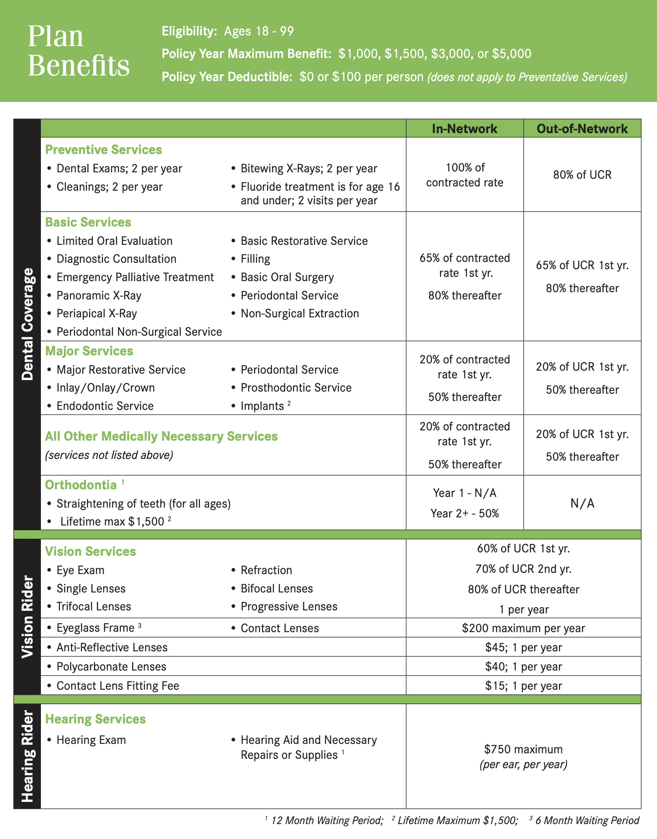
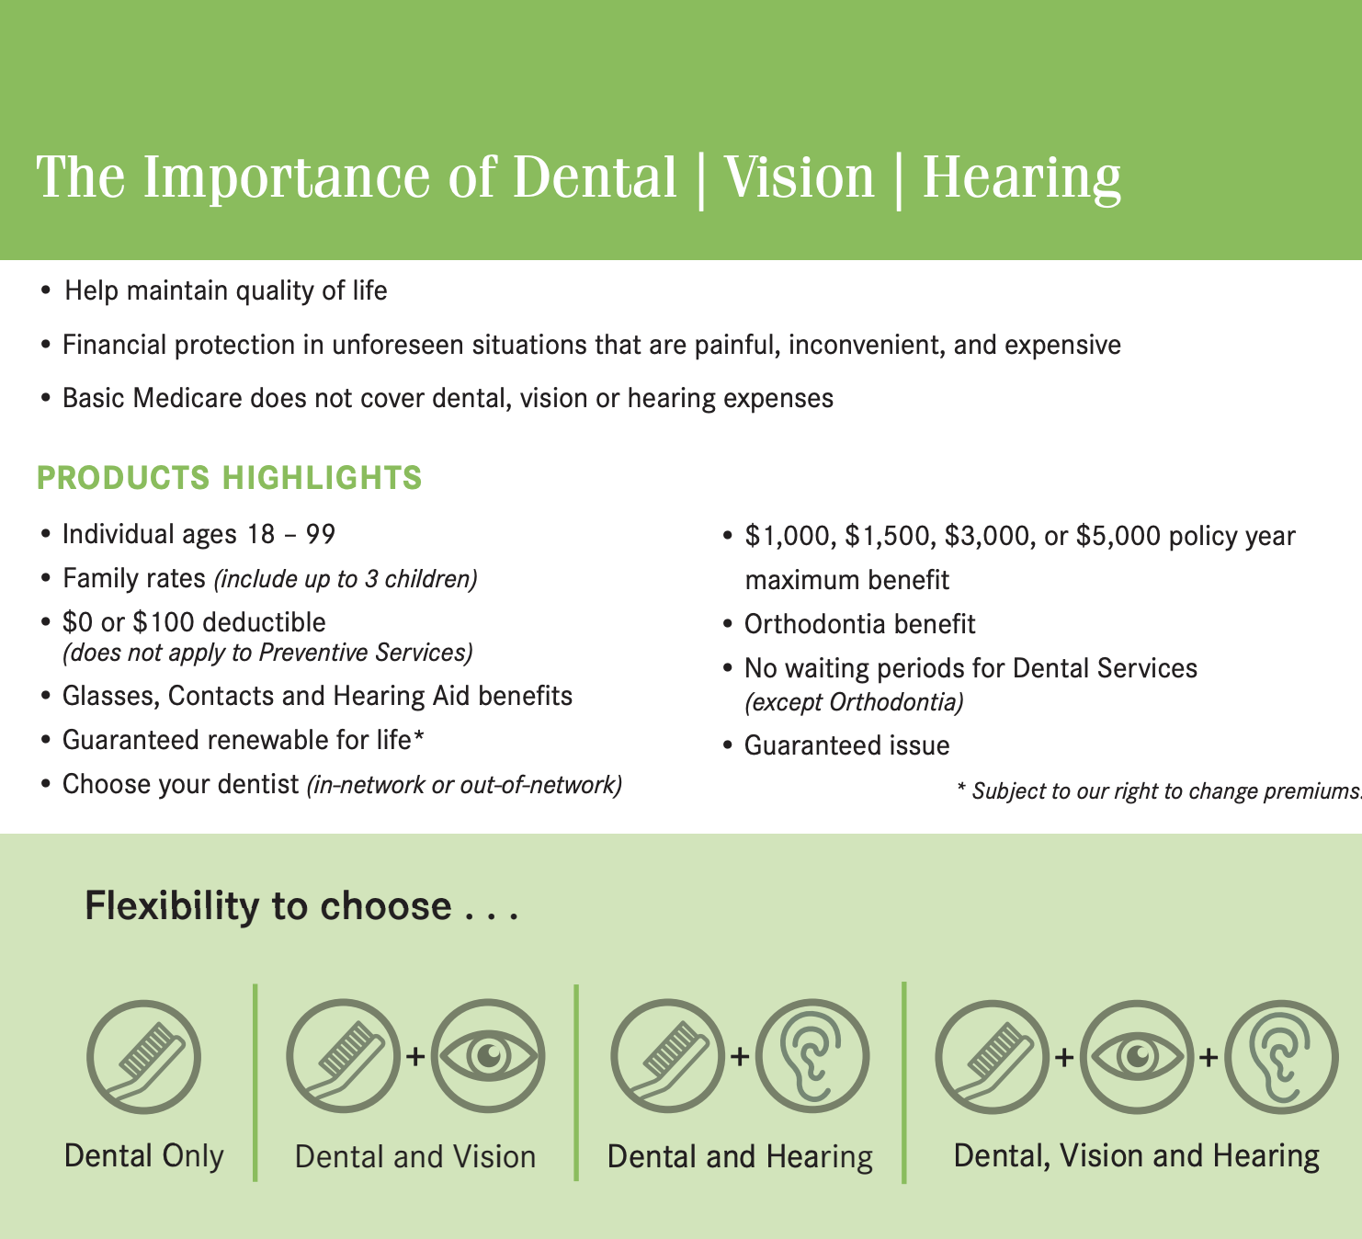
Manhattan Life DVH Select

Slide 23
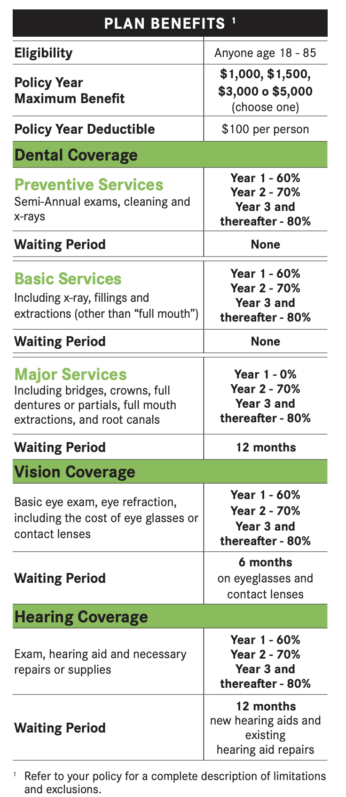
Manhattan Life DVH Traditional

Slide 24
Manhattan Life DVH Network

Slide 25
DVH Questions to Ask Prospective Clients
Ask one of these questions to EVERY person you talk to!
Who do you have for dental insurance?
When was the last time you had your teeth cleaned?
What are you going to do when you have a dentist tell you that you need a crown and root canal and cant get it covered by Medicare? What do you think that will do to your income if you have to pay $2,000- $2,500?
Would you rather pay $1 a day for DVH coverage or get a care credit card application approved for $2,500 with a huge amount of interest?

Slide 26
Common Objections and How to Overcome
I’ve never seen the value in a DVH plan.
My dentist doesn’t take insurance.
I don’t have teeth
I need coverage for major dental work NOW.

Slide 27
WHAT’S IN IT FOR ME?
Average Cancer, Heart Attack or Stroke annual premium is $350
80% 1st year commission in most states – Year 1 comp just increased 25%!!!
6% renewal comp (yrs. 2-10) in most states
$350 x 80% = $280 in 1st year commissions
1 sale per week = $14,560 in new CHAS commission on top of your Med Sup, MA and/or ACA commission from the same client!
Policy pays a maximum 9-month advance
Clients rarely drop CHAS because the premiums are reasonable and they’re afraid they’ll get CHAS after they drop it.
How does Aetna’s commission compare?
Aetna | GTL | Cigna | Mutual of Omaha
80% | 50% | 60% | 60%
Street level commissions, may vary by state.
FOR AGENT USE ONLY

Slide 28
“Spouse in the House”
Common Packages of Protection
ACA PLAN WITH OR WITHOUT SUBSIDY
AFFORDABLE CHOICE
HOSPITAL INDEMNITY SELECT
CANCER
DENTAL, VISION & HEARING
HEART ATTACK & STROKE
24 HOUR ACCIDENT/ P.A.I.D
SHORT TERM OMNI FLEX / HHC
LIFE INSURANCE
MED ADVANTAGE PLAN
HIP (MANHATTAN EXCLUSIVE)
CANCER
SHORT TERM OMNI FLEX / HHC
DENTAL, VISION & HEARING
LIFE INSURANCE
MEDICARE SUPPLEMENT
DENTAL, VISION & HEARING
CANCER
SHORT TERM OMNI FLEX / HHC
LIFE INSURANCE
FOR AGENT USE ONLY

Slide 29
What’s In It For Me?
FIRST YEAR COMPS ONLY, RENEWALS ARE NOT INCLUDED IN EXAMPLE
ACA, MA & MED SUPP COMP NOT INCLUDED
STREET LEVEL COMMISSIONS (TEXAS)
FOR AGENT USE ONLY
Product | Monthly Premium | Commission Rate | Monthly Commission | First Year Commission
Affordable Choice | $278.76 | 30% | $83.63 | $1,003.54
HI Select | $62.31 | 30% | $18.69 | $224.32
Lump Sum Cancer Plan | $62.50 | 80% | $50.00 | $600.00
Lump Sum Heart Attack/Stroke Plan | $19.17 | 80% | $15.34 | $184.08
24 Hour Accident Plan | $35.31 | 30% | $10.59 | $127.12
Home Healthcare | $32.80 | 60% | $19.68 | $236.16
Omni Flex | $97.00 | 55% | $53.35 | $640.20
Dental, Vision & Hearing | $59.58 | 40% | $23.83 | $285.98
Final Expense | $27.90 | 105% | $29.30 | $351.54
TOTAL AGENT ANNUAL INCOME |  |  |  | $3,652.94
*premium based on female age 59 non smoker TX
** 3 of these packages at 50 weeks would create a $505,941 annual income in first year commissions
This table is adjustable, feel free to play around with it by adding in your commission percentages.

Slide 31
Q&A

Slide 32
Thank You!

